Slide 1
The SQL Server 2019 Workshop https://aka.ms/sqlworkshops
Microsoft Azure Data SQL Server Engineering
November 2019

Slide 2
SQL Server 2019 Workshop Modules
01 Introduction to SQL Server 2019
02 Intelligent Performance
03 Security
04 Availability
05 Modern Development Platform
06 Linux and Containers
07 SQL Server on Kubernetes
08 Data Virtualization
09 Big Data Clusters
10 Additional Capabilities, Migration, and Next Steps

Slide 3
Module 01 Introduction to SQL Server 2019
Notes:
TODO: Would be nice to have icon here

Slide 4
Businesses face broad challenges if they do not modernize
Expensive ETL for integrating external data sources
Siloed relational and big data
Time-consuming query performance tuning
Meeting data security and compliance standards
Keeping data and applications always available.
Performance affected by unreliable I/O latency
Finding a consistent database across platforms and languages
Barriers to creating intelligent apps with AI and ML

Slide 5
It’s built on a strong foundation
Major capabilities of SQL Server 2016 and 2017
Intelligent performance
Query Store
Adaptive Query Processing
Automatic Tuning
Columnstore and In-Memory OLTP
“It Just Runs Faster”
Layers of security
Always Encrypted
Row Level Security
Dynamic Data Masking
Mission critical availability
Clusterless Availability Groups
Distributed Transactions for Availability Groups
Resumable Index Maintenance
Developer experience
JSON
Temporal Tables
Graph Database
Modern platform
Linux and Containers
Machine Learning Services with R and Python

Slide 6


SQL Server 2019
Industry-leading performance and security, with intelligence over all your data
Intelligence over any data
Choice of platform, language and container
Industry-leading performance and availability
Most secure over the last 9 years⁵
Insights in minutes on any device
+
#1 OLTP performance¹
#1 DW performance on 1TB², 10TB³, and 30TB⁴
Intelligent Database
PHP
Node.js
C#/VB.NET
AI and Machine Learning over all data with the power of SQL and Spark
T-SQL
Java
C/C++
Python
Ruby
The best of Power BI and SQL Server Reporting Services with Power BI Report Server
In-memory across all workloads
Most consistent data platform
Edge
Private cloud
Public cloud
1/10th the cost of Oracle
All TPC Claims as of 9/23/2019.
¹ http://www.tpc.org/4081; ² http://www.tpc.org/3331; ³ http://www.tpc.org/3336; ⁴ http://www.tpc.org/3337; ⁵ National Institute of Standards and Technology Comprehensive Vulnerability Database

Slide 7









SQL Server 2019 solves modern data challenges
Data virtualization and Big Data Clusters
Built-in Machine Learning and extensibility
Modern platforms with compatibility
R
PolyBase
SQL
Cosmos DB
ARM64
Microsoft SQL Server
Intelligent performance
Business critical High Availability
Layers of security and compliance
Query
ciphertext
Secure Enclaves
Learn
Memory grant
In-memory database
Data Classification
plaintext
Run query
Accelerated Database Recovery
Notes:
TODO:
Change ordering
Final order will be
Top left to right
Data Virt
Modern Plat
ML and Ext
Bottom left to right
Perf
Security
High Avail
Add Teradata icon to Data Virtualization.
Take off CosmosDB
Keep k8s, Hadoop and Spark/SQL together
For Modern platforms with compatibility add general containers icon. Ordering of icons should be Windows, Linux, Container, k8s, arm64
In Intelligent performance put Intelligent Query Processing under the Memory grant chart
For Business Critical High Availability let’s just put Accelerated Database Recovery and icon in that box

Slide 8
Module 02 Intelligent Performance
Notes:
TODO: Put in play button icon here

Slide 9

SQL Server 2019 Industry-leading performance
Challenge
DBA’s spend most of their time tuning database performance, leading to high operational costs
Intelligent Database
Performance
Improves performance with no app change
Solution
Automation with Intelligent Database capabilities while providing mission critical performance
App
Gain performance with no app changes with Intelligent Query Processing
Performance insights anytime anywhere with Query Store and lightweight query profiling
Accelerate I/O performance with Persistent Memory
Persistent Memory
Query Store
Notes:
For presenter, talk through slides but spend more time on details for LQP
TODO: Add in 2019 benchmark result

Slide 10
Gain performance without changing the application
The Intelligent Performance feature family
Intelligent QP
Adaptive QP
Table Variable Deferred Compilation
Batch Mode for Row Store
Approximate QP
Scalar UDF inlining
Intelligent Query Processing
Sequential Key Insert Performance
In-Memory Database
Hybrid Buffer Pool
Persistent Memory Support
Memory-Optimized TempDB Metadata
Adaptive Joins
Interleaved Execution
Memory Grant Feedback
Approximate Count Distinct
Batch Mode
Batch Mode
Row Mode
Intelligent performance
Bold indicates new and improved features in SQL Server 2019
Notes:
Talk through the slide and spend time on each feature except for tempdb which is in next slide

Slide 11
Tempdb Just Runs Faster
The problem(s)
High multi-user rates of tempdb usage can lead to latency due to….
allocation page latch waits – Multiple users needing to allocate pages for temp tables
system table page latch waits – High rates of create/drop require system table modifications
The Solution
Create multiple files to partition allocation pages
SQL Server 2016+ creates multiple tempdb files during setup
Start with 8 and add by 4 until concurrency alleviated
But…what about system tables?
The SQL 2019 Solution
Key tempdb system tables become SCHEMA_ONLY memory optimized tables
Latch and lock free
Turn on with ALTER SERVER CONFIGURATION
This is NOT user data just metadata so memory requirements small

Slide 12
Module 02 Activity: Intelligent Performance

Slide 13
Module 03 Security
Notes:
TODO: Put in security icon here

Slide 14
SQL Server confidential computing
Always Encrypted with secure enclaves
plaintext
ciphertext
Always Encrypted with secure enclaves
Data Classification and auditing built-in
TDE scan suspend and resume
Simplified certificate management
Enhanced client driver
Enclave
plaintext
Layers of security
Notes:
Go through each item but not as much on Data Classification since that is on next slide

Slide 15
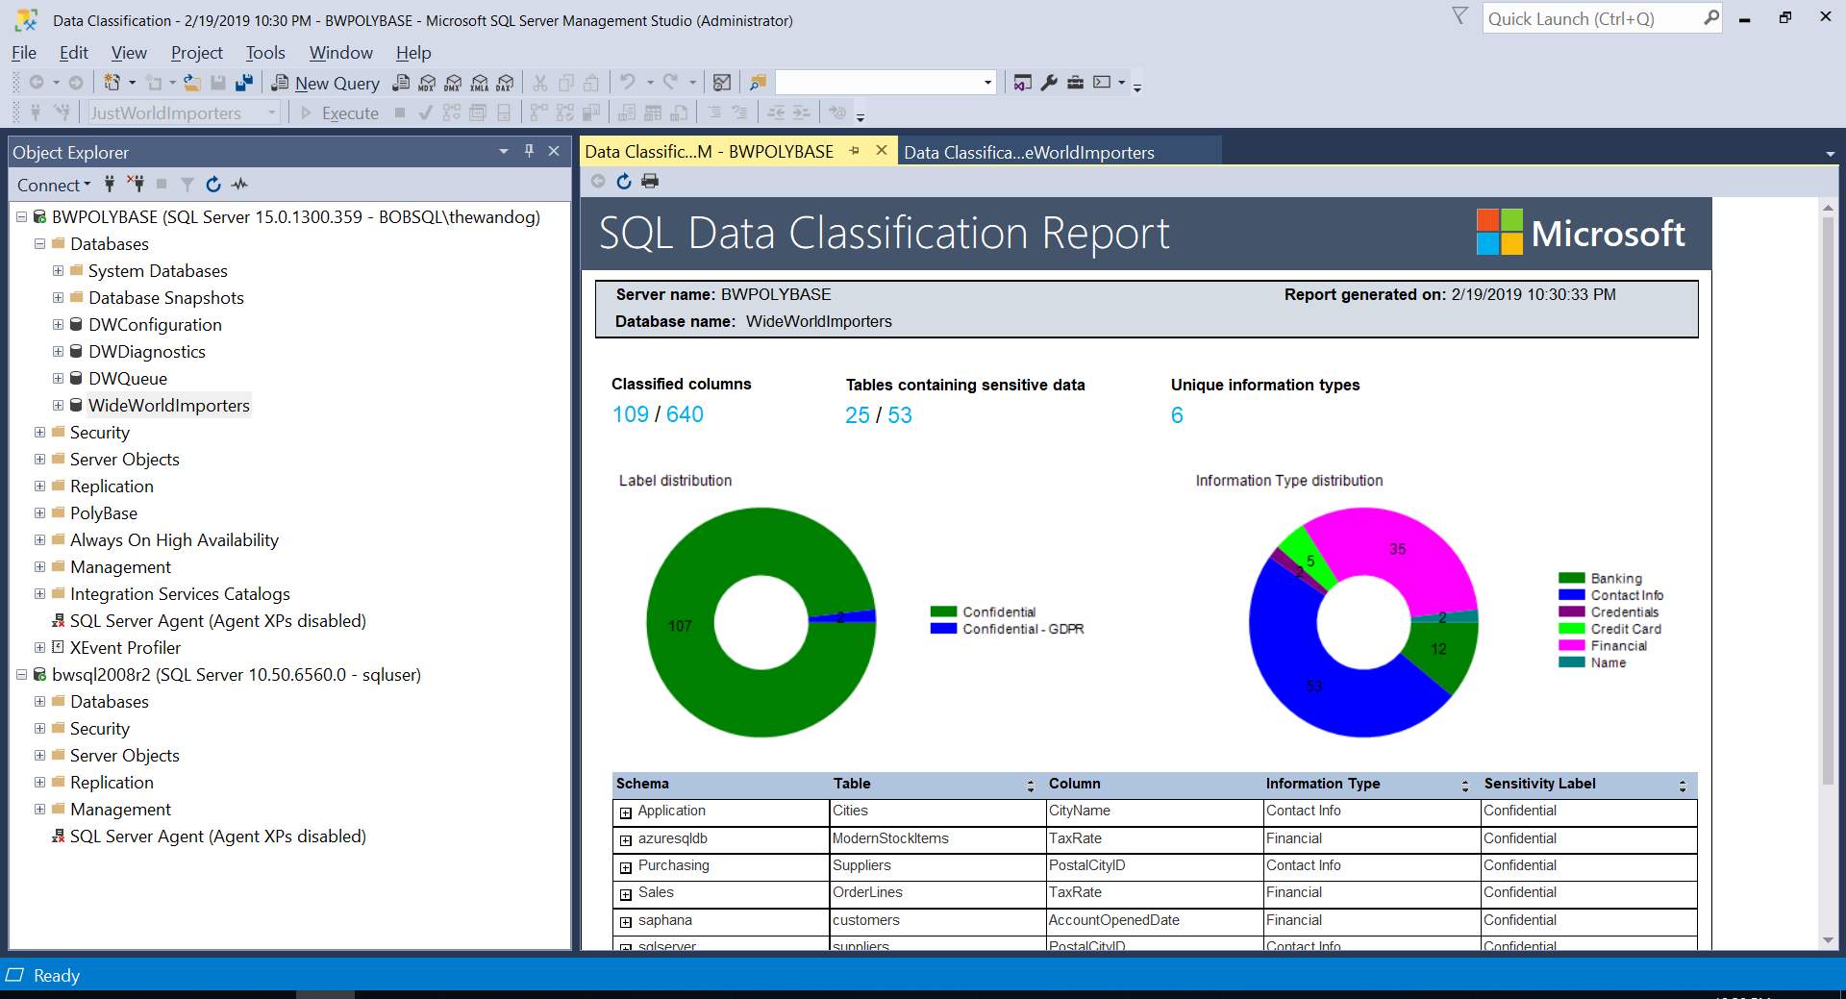
Data Classification and Auditing
The problem
I need to classify my data in SQL Server and audit access to the classified data
SQL Server 2017
SQL Server 2019 and Azure SQL Database
ADD SENSITIVITY CLASSIFICATION TO
dbo.sales.price, dbo.sales.discount
WITH ( LABEL='Highly Confidential', INFORMATION_TYPE='Financial' )
SQL Server 2019
SQL Server Auditing
data_sensitivity_information
Who, what, and when accessed my classified data?

Slide 16
Module 03 Activity: Data Classification

Slide 17
Module 03 High Availability

Slide 18
SQL Server 2019 SQL Server is always highly available
Recovery phase/Transaction log/sLog (with ADR)
Challenge
Log Grows out of Control
Long rollback blocks applications
Long Recovery prolongs downtime
Oldest uncommitted Tx (XACT_BEGIN_LSN)
Last checkpoint (or oldest dirty page LSN)
End of log
Phase 1: Analysis
Solution
Always keep your data available to your application
Phase 2: Redo from sLog
Phase 2: Redo
Phase 3: Undo from sLog
sLog is persisted to disk as part of checkpoint
Only this portion of the Transaction Log is scanned.
Accelerated Database Recovery (ADR)
Online Index enhancements
Availability group enhancements
Transaction Log
Start of log
sLog
Log records for non-versioned ops are copied to sLog
Business critical high availability
Notes:
Spend time on all 3. Tell the story of ADR here and next slide is for more details

Slide 19
Accelerated Database Recovery (ADR)
Enable/disable as a database option
Use a Persisted Version Store (PVS)
Independent of locking and isolation levels
Rollback faster than you can react
Undo recovery faster than you can look it up in the ERRORLOG
Transaction log truncation not tied to active transactions
Powers Hyperscale
Does it require more space?
Will it affect performance?
Will I still see versions in tempdb?
How does it work with Always On Availability Groups?
Notes:
Format and separate the two sections

Slide 20
Module 04 Activity: Accelerated Database Recovery

Slide 21
Module 05 The Modern Development Platform

Slide 22


Enhance development with more flexible tools
Extend T-SQL with R, Python, and Java
Satellite
SQL Graph enhancements
UTF-8 support
Machine Learning Services enhancements
SQL Server Language Extensions and the Extensibility Framework
T-SQL
Direct communications for performance
Launch pad
Developer experience
Notes:
Cover layers of security, isolation, and resource governor for extensibility framework

Slide 23
Module 05 Activity: Extending T-SQL with Java

Slide 24
Module 06 SQL Server 2019 on Linux and Containers

Slide 25

Platform of choice with compatibility
Windows
Linux
New capabilities for Linux
Replication
Change Data Capture
Distributed transactions
Machine Learning
Polybase
Tempdb files auto-config
Containers
Microsoft Container Registry
Red Hat Images
Non-root Containers
Containers and Kubernetes
Modern platform
Notes:
TODO: Dv01 icon on this slide

Slide 26

Why SQL Server Containers?
Portable
Run anywhere containers are supported
Lightweight
Reduced disk, CPU, and memory footprint
Consistent
Consistent image of SQL Server, scripts, and tools
Efficient
Faster deployment, reduced patching, and less downtime
Container configuration
Persisted storage
Database
Switch for
simple updates
Container
Container
Container
sqlservr
sqlservr
sqlservr
Container Runtime
Bins/libs
Bins/libs
Bins/libs
Host OS
Infrastructure
Notes:
The right diagram is to show how to update SQL Server by “switching” containers

Slide 27

Linux and Windows Containers Explained
Linux Image on Linux host
Linux Native Process
Linux Image on Windows host
Run in a Linux Virtual Machine
LCOW – Virtualized process
WSL2 – Virtualized process
Windows image on a Windows host
Process Isolation - Native Windows Process
Hyper-V Isolation – Virtualized Process
Windows image on Linux host

Slide 28
The new update for SQL Server
SQL Server 2017 CU8 Container
volume
rollback
SQL Server 2017 Latest Container
update
SQL Server
databases
SQL Server 2019
upgrade

Slide 29
Module 06 Activity: Linux and Containers

Slide 30
Module 07 SQL Server on Kubernetes

Slide 31
The What and Why of Kubernetes?

Slide 32
The Kubernetes Architecture

Slide 33
The Kubernetes Landscape

Slide 34

SQL Server - Shared storage HA in Kubernetes
Built-in HA orchestration with no clustering required
Kubernetes
Node
Node
Node
Application
Load Balancer Service
Pod
Pod
SQL Server
SQL Server
Pod
SQL Server
ReplicaSet
Persistent Volume Storage

Slide 35
Module 07 Activity: SQL Server on Kubernetes

Slide 36








Module 08 Data Virtualization
HDFS

Slide 37
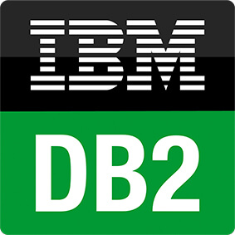






SQL Server 2019 — Intelligence over any data Remove data silos
Challenge
Integrating data from numerous data silos is complex with traditional ETL methods
Solution
Access data from numerous data sources without moving data
T-SQL
…
Integrate data with data virtualization
T-SQL language with external tables
Distributed/scalable performance with Polybase
ODBC
NoSQL
Relational databases
Big Data
Azure SQL Database
Azure Cosmos DB
Excel

Slide 38
What is SQL Server Polybase?
“It’s all about
Data Virtualization”
It all started with T-SQL against Hadoop
Query data where it lives using T-SQL
Distributed compute engine integrated with SQL Server
Distributed, scalable query performance
Manual/deploy with SQL Server
Auto deploy/optimize with Big Data Clusters
Analytics
T-SQL
Apps
SQL Server
PolyBase external tables
ODBC
NoSQL
Relational databases
Big data
Excel
Cosmos DB
HDFS
Intelligence over all data

Slide 39
The SQL Server Polybase Architecture
control and
execution
Data flow
EE only
All editions
All editions
“Head” node
“Compute” node
“Compute” node
DW dbs
SQL Engine
DW dbs
SQL Engine
DW dbs
SQL Engine
tempdb
tempdb
tempdb
Need more scale?
Add compute nodes
Polybase Engine
Polybase Engine
Polybase Engine
……...
Polybase Data Movement Service
Polybase Data Movement Service
Polybase Data Movement Service
Scan or pushdown
Scale out with partitions
shuffle
mpdwsvc.exe
Your data sources
Cosmos DB
HDFS

Slide 40
Data virtualization examples in SQL Server 2019
Legacy SQL Server
Azure SQL Database
Azure Cosmos DB
Legacy suppliers
Modern stock items
Mobile app orders
SQL Server 2019
Customers from acquisition
Accounts receivable
Order reviews
Notes:
This is a great example for a company that has existing data sources but doesn’t want to or cannot move the data.

Slide 41
Module 07 Activity: Using Polybase with SQL Server 2019

Slide 42
Module 09 Big Data Clusters

Slide 43
Intelligence over all of your data
Data virtualization
Managed SQL Server, Spark, and Data Lake
Complete AI platform
Admin portal and management services
Integrated AD-based security
Analytics
T-SQL
Apps
REST API containers for models
SQL Server External Tables
SQL Server
Spark
SQL Server
ML Services
Spark & Spark ML
Compute pools and data pools
Scalable, shared storage (HDFS)
Open database connectivity
NoSQL
Relational databases
HDFS
External data sources
HDFS
Combine data from many sources without moving or replicating it
Scale out compute and caching to boost performance
Store high volume data in a data lake and access it easily using either SQL or Spark
Management services, admin portal, and integrated security make it all easy to manage
Easily feed integrated data from many sources to your model training
Ingest and prep data and then train, store, and operationalize your models all in one system
Notes:
BDC is all about providing the install and configuration of Polybase automatically but if you don’t have Hadoop we will install one for you and include Spark with it. The right side of the slide is about using BDC as a complete ML/AI platform. All of this deployed on a cluster that is secure and provides built-in management, HA, and scale using Kubernetes.
Breadcrumb here for Data Virt

Slide 44
Why SQL Server Big Data Clusters?
Deployed single solution
Deployed SQL Server with built-in Availability Groups and Active Directory Authentication
Use Data Virtualization through deployed Polybase Scale Out Groups
A deployed HDFS Cluster
Access HDFS with built-in Polybase connector through an optimized SQL Server Engine
A deployed Spark engine
A deployed built-in Data Mart for cached or offline results using a built-in Polybase connector
Access to Machine Learning with SparkML and SQL Server Machine Learning Services
Deploy applications such as Machine Learning Models and SSIS packages
Deployed set of services for control, management, and monitoring
Use the power of containers and Kubernetes for basic HA, storage, networking, and scale.

Slide 45









SQL Server 2019 Big Data Clusters
The combination of SQL Server database engine, Spark, and HDFS enable diverse big data scenarios
Removing data silos
Manage both structured and unstructured data
AI over all your data
Custom apps
BI
Analytics
SQL Server master instance
Kubernetes
Scale performance with Compute pool
Languages
Any external data source
…
App Deploy
PolyBase
SQL Compute Node
SQL Compute Node
…
SQL Compute Node
Data lakes with Storage pool
REST API containers for models
Spark
SQL Server
Spark
SQL Server
…
Spark
SQL Server
Scale out data mart with Data pool
HDFS
HDFS
HDFS

Slide 46
Deep into the Architecture of Big Data Clusters
Control
Controller Svc
Proxy
Kibana
Grafana
Custom apps
Configuration Store (SQL Server)
Elastic Search
InfluxDB
BI
Analytics
Cluster
SQL Server master instance
AG Replicas
SQL
SQL
SQL
External data sources
Compute pool
Directly read from HDFS
SQL Compute Instance
SQL Compute Instance
SQL Compute Instance
SQL Compute Instance
SQL Compute Instance
…
SQL Compute Instance
Application pool
Data pool
Storage pool
Application
SQL Datapool Instance
SQL Datapool Instance
Spark
SQL Server
Spark
SQL Server
Spark
SQL Server
…
HDFS Datanode
HDFS Datanode
HDFS Datanode
IoT data
Storage
Storage
Kubernetes pod
Node
Node
Node
Node
Node
Node
Node
Persistent storage
HDFS Tiering
Notes:
Increase analytics and apps performance with scale out data pools

Slide 47
Deploying a Big Data Cluster
Kubernetes choices
Azure Kubernetes Service (AKS)
Your Kubernetes Cluster (kubeadm)
Deployment Tools
azdata CLI to deploy
Customize with json
Azure Data Studio Wizard and Notebook deployment
Single deployment solutions
Python script for AKS
Bash script for kubeadm
Deployment Guidance
Minimum 8 CPUs, 64Gb RAM, 100Gb Disk, 24 disks
Offline supported

Slide 48








Using a Big Data Cluster through Endpoints
sql-server-master
SQL Server Master Instance
controller
Cluster Management Service
gateway
Gateway to access HDFS files, Spark
webhdfs
HDFS File System Proxy
livy
Proxy for running Spark statements, jobs, applications
app-proxy
Application Proxy
tds
Schedule
SSIS packages
sql-server-master-readonly
Always On
Availability Group

Slide 49
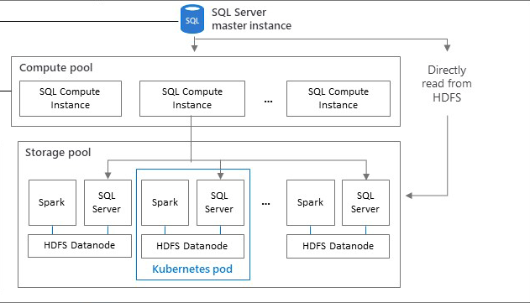


Using the Storage Pool
sqlhdfs connector
Compute Pool used if exists
HDFS name node deployed
YARN deployed
SQL Server engine in pool reads HDFS directory
webhdfs or livy endpoints
Zookeeper for HA
Mount external HDFS with Tiering
HDFS Tiering

Slide 50
Using the Data Pool
sqldatapool connector
INSERT, SELECT, TRUNCATE TABLE, EXECUTE AS
SQL Server instances with sharded data using columnstore
Ingest with T-SQL from any data source
Ingest with Spark from HDFS
Use for cached or offline results
Custom apps
BI
Analytics
Cluster
SQL
SQL Server master instance
Compute pool
SQL Compute Instance
SQL Compute Instance
…
SQL Compute Instance
Data pool
SQL Datapool Instance
SQL Datapool Instance

Slide 51
Spark and Machine Learning
Run Spark jobs through notebooks or livy endpoint
Ingest data with Spark into HDFS or external tables
Build machine learning models with SparkML or SQL Server Machine Learning
Connect to SQL Server using the MSSQL Spark Connector
Deploy a Spark pool to enable more compute
Deploy a Machine Learning model with Application Deploy

Slide 52
Managing and Monitoring Big Data Clusters
Management Endpoints
metricsui -Metrics with Grafana
logsui - Logging with Kibana
spark-history - Spark Job History
yarn-ui – Spark Job Diagnostics
azdata is the “kubectl” of Big Data Clusters
Dashboards with Azure Data Studio
Troubleshooting Guides with Notebooks
Use kubectl
Copy files into containers like Database Backups
Dive into logs like SQL ERRORLOG files
Dive into Kubernetes events and pod details

Slide 53
Module 09 Activity: Using Big Data Clusters

Slide 54
Module 10 Additional Capabilities, Migration, and Next Steps

Slide 55
Voice of the customer
User experience
The #1 voted customer feedback item of all time: String Truncation
MAXDOP and Memory Config during Setup
Memory Grant Percent in Resource Governor
Estimate compression for Columnstore indexes
Diagnostics
Troubleshoot page waits with new built-in T-SQL
Diagnostics for auto stats blocking
Custom capture policy for the Query Store
Columnstore stats in DBCC CLONEDATABASE
Performance
Reduce recompiles for tempdb workloads
Indirect Checkpoint Scalability
Concurrent PFS updates
Worker Stealing
Inline Log Writes
String or binary data would be truncated
String or binary data would be truncated
in table '%.*ls', column '%.*ls’.
Truncated value: '%.*ls'
SELECT page_info.*
FROM sys.dm_exec_requests AS d
CROSS APPLY sys.fn_PageResCracker(d.page_resource) AS r
CROSS APPLY sys.dm_db_page_info(r.db_id, r.file_id, r.page_id,'DETAILED’)
AS page_info;
Notes:
TODO: Worker stealing and inline log writers.

Slide 56
What’s new SQL Server Analysis Services 2019
Modeling & Analytics
Calculation groups
Many-to-many relationships
SuperDAXMD (Multidimensional)
Online attach
Resource governance
Control Power BI background refreshes
ClientCacheRefreshPolicy
Memory management:
QueryMemoryLimit
RowsetSerializationLimit
Query interleaving (coming soon in Azure AS):
SchedulingBehavior

Slide 57



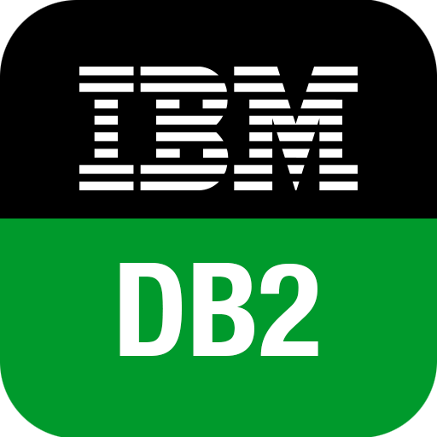

Migrate to the modern SQL Server
Migration from legacy SQL Server
Migration from external databases
Database Experimentation
Assistant
Legacy SQL Server
SQL Server 2017
SQL Server 2019
SQL Server in Azure Virtual Machine
SQL Server
In-Place (Windows)
Database Backup
Log Shipping
Bulk Import
SSIS
Microsoft Access
Data Migration Assistant
Azure Database Migration Service
SQL Server Migration Assistant (SSMA)
Query Tuning Assistant

Slide 58
Certify once with Compatibility Certification
Upgrade & modernize your SQL Server database on-premises, in the cloud and on the edge with Compatibility Certification that eliminates risks of application compatibility
Upgrade to the latest SQL Server Database Engine without changing your critical applications
Compatibility Certification benefits
Unified application certification
Applications tested and certified on a given SQL Server version are also implicitly tested and certified on that SQL Server version native database compatibility level
Reduce upgrade risks
Separate application and platform layer upgrade cycles for less disruption
Microsoft fully supports Compatibility Certification
Frictionless migration with no code changes
Upgrade to latest SQL Database Engine version
Upgrade your SQL Server Database Engine or move instances to the cloud with no code changes
Notes:
Starting with SQL Server 2016, the SQL Server team has stopped deprecating compatibility levels purposefully. The Database Engine is also literally the same accross SQL Server and Azure SQL (including Managed Instance), so a database can be moved seamlessly and the same database code (T-SQL) works the same and undergoes the same optimization processes.​
Therefore, an application that was certified for compatibility 100 (SQL 2008) can work with the same behavior that was set for that version, even when moved to Azure SQL or a modern version of SQL Server.​
This means:​
•No more need to specifically certify for Azure or on-premises separately. Applications tested and certified on a given SQL Server version are also implicitly tested and certified on that SQL Server version native database compatibility level.​
•Reduced upgrade risks because during platform modernization, application and platform layer upgrade cycles can be separated for less disruption, and improved change management​
•Upgrading to a new version of SQL Server or Azure SQL can be done with no code changes by keeping the same compatibility level as the source​
New Databases are set to compatibility level mapping to the version of the Database Engine. When a database is upgraded from any earlier version of SQL Server, the database retains its existing compatibility level if it is at least minimum allowed for that instance of SQL Server or Azure SQL. Upgrading a database with a compatibility level lower than the allowed level (for example from SQL 2005), sets the database to the lowest compatibility level allowed.

Slide 59
SQL Server 2019 Editions
Build once and deploy across any SQL Server edition without changing your app
Enterprise
Mission-critical performance and intelligence for tier 1 databases
Standard
Full featured database with Big Data Clusters for mid-tier applications and data marts
Feature highlights
Unlimited cores of CPU
Unlimited memory
Industry-leading performance with unmatched scalability
Unlimited virtualization benefits
Petabyte scale data warehousing
Business critical HA on Windows and Linux
Low TCO with free DR replicas
Access to Power BI Report Server
Express/web
Free, entry-level database for small web and mobile apps
Feature highlights
Up to 24 cores of CPU
Up to 128 GBs of memory
SQL Server 2019 Big Data Clusters
Data virtualization through PolyBase
Enhanced in-memory performance
Automatic intelligent database tuning
Azure Data Studio with notebook support
Feature highlights
Up to 16 cores of CPU
Up to 64 GBs of memory
In-memory OLTP and Columnstore
End-to-end encryption with secure enclaves
Full T-SQL surface area
Support for Linux and Windows containers
UTF-8 character encoding
Data classification and auditing
+ Standard features
+ Express/web features
+ Express/web features
Developer
Free to use with all the features of Enterprise Edition specifically for dev/test in non-production environments
Notes:
TODO: Standard should IMHO call out the new things like TDE, ADR

Slide 60
Wrap-up and Q&A

Slide 61
Get Started With SQL Server 2019
Download and try it at
http://aka.ms/ss19
Use our free training at
https://aka.ms/sqlworkshops
Learn from videos and demos at
https://aka.ms/sqlchannel
What’s new for SQL 2019
documentation
Modernize SQL Server
check out the video
Notes:
This needs alignment and spacing better
TOOD: Add Licensing
Check out our Licensing Guide at xxxxxxxx

Slide 62
Learn more
http://aka.ms/bobwardms
http://aka.ms/bobsqldemos
http://aka.ms/sqllinuxbook
Use our free training at https://aka.ms/sqlworkshops
Learn from videos and demos at https://aka.ms/sqlchannel
Download and try it at http://aka.ms/ss19
What’s new for SQL 2019 documentation
Sign-up for the EAP program at https://aka.ms/eapsignup

